Slide 1
Loan Prediction Dataset ML Project
Utilizing Machine Learning Algorithms
By: 6961 SHARON PHILIP

Slide 2
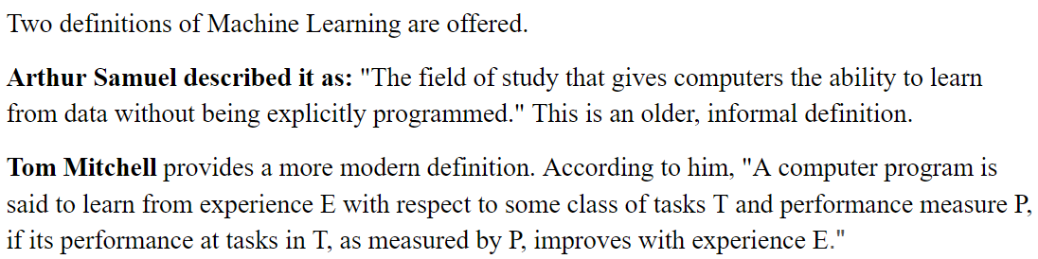
Two definitions of Machine Learning are offered.
Arthur Samuel described it as: "The field of study that gives computers the ability to learn from data without being explicitly programmed." This is an older, informal definition.
Tom Mitchell provides a more modern definition. According to him, "A computer program is said to learn from experience E with respect to some class of tasks T and performance measure P, if its performance at tasks in T, as measured by P, improves with experience E."

Slide 3
Loan Prediction
In finance, a loan is the transfer of money by one party to another with an agreement to pay it back. The recipient, or borrower, incurs a debt and is usually required to pay interest for the use of the money.
The document evidencing the debt (e.g., a promissory note) will normally specify, among other things, the principal amount of money borrowed, the interest rate the lender is charging, and the date of repayment. A loan entails the reallocation of the subject asset(s) for a period of time, between the lender and the borrower.
The interest provides an incentive for the lender to engage in the loan. In a legal loan, each of these obligations and restrictions is enforced by contract, which can also place the borrower under additional restrictions known as loan covenants. Although this article focuses on monetary loans, in practice, any material object might be lent.
Acting as a provider of loans is one of the main activities of financial institutions such as banks and credit card companies. For other institutions, issuing of debt contracts such as bonds is a typical source of funding.

Slide 4
IMPLEMENTATION OVERVIEW [LIBRARIES]
os:operating system
Numpy: Numerical Python
Pandas:for analyzing, cleaning, exploring, and manipulating data
Matplotlib.pyplot: a collection of command style functions that make matplotlib work like MATLAB.
seaborn:data visualization

Slide 5

Machine learning MODEL
from sklearn.tree import DecisionTreeClassifier:
A decision tree classifier
from sklearn.ensemble import RandomForestClassifier:
A random forest classifier

Slide 6
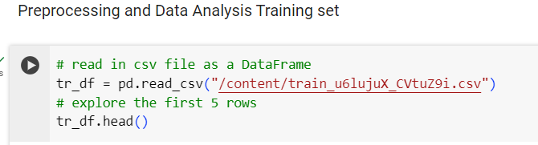
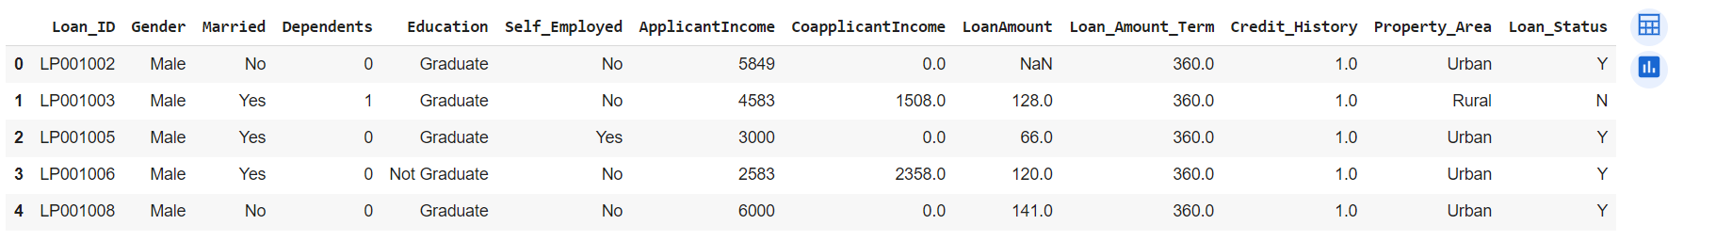
Preprocessing Datasets trained & tested

Slide 7
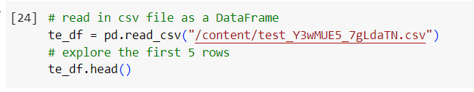
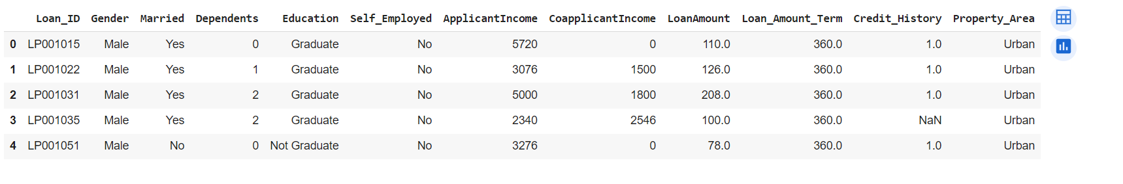
Tested data

Slide 8
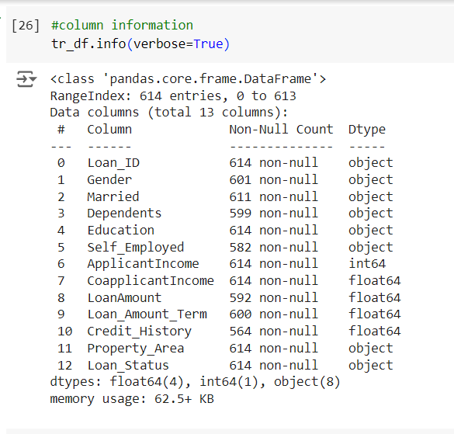
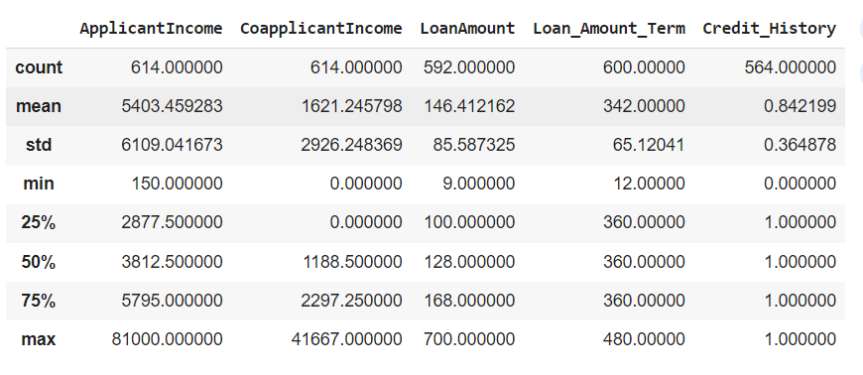

Slide 9
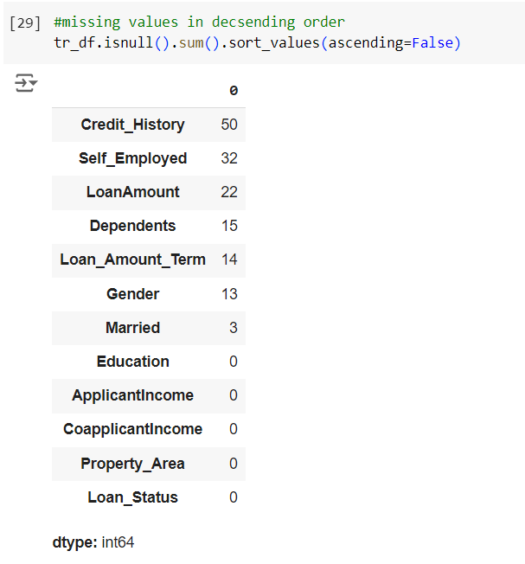
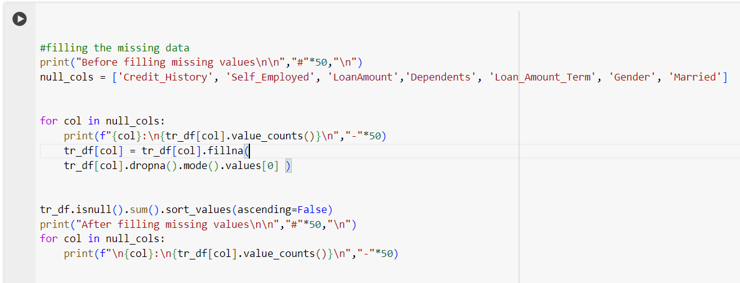
Missing value

Slide 10
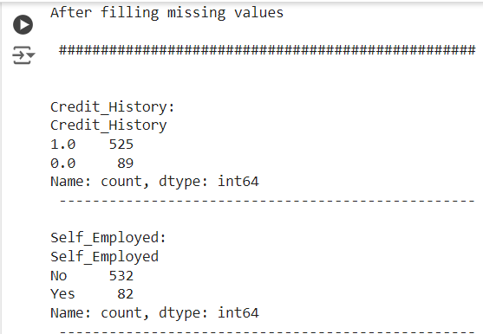
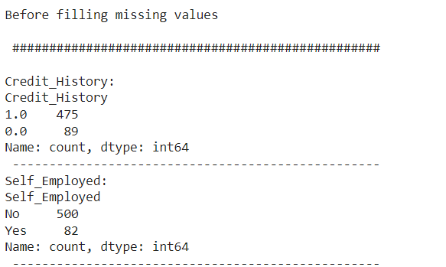
Before & after filles

Slide 11
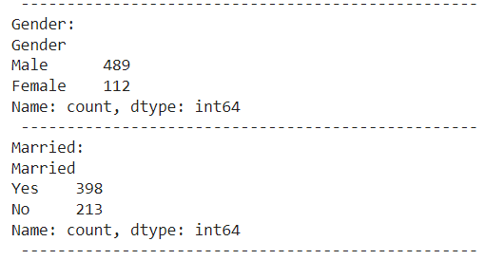
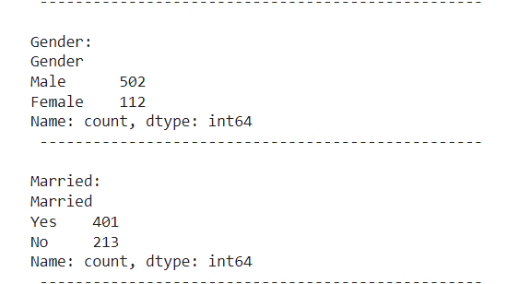
Gender & married

Slide 12
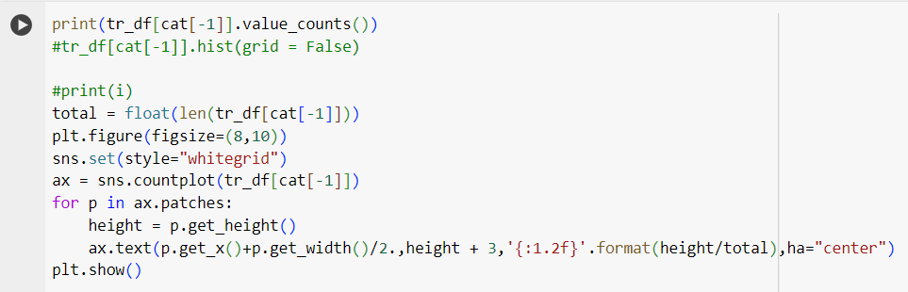
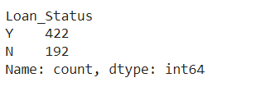
Loan status distribution

Slide 13
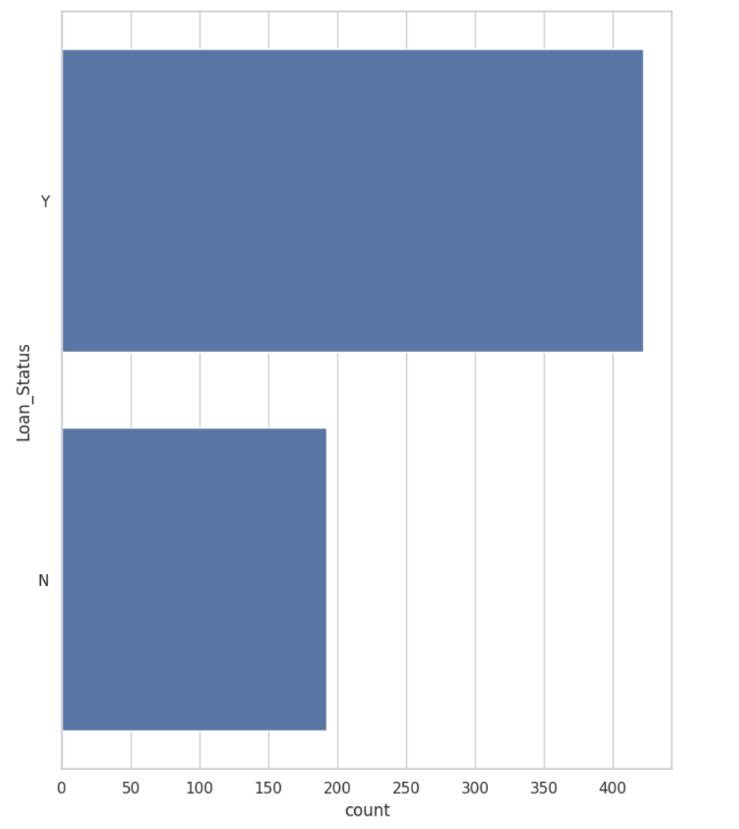
Status of loan

Slide 14
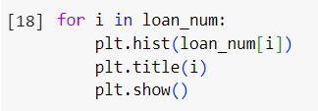
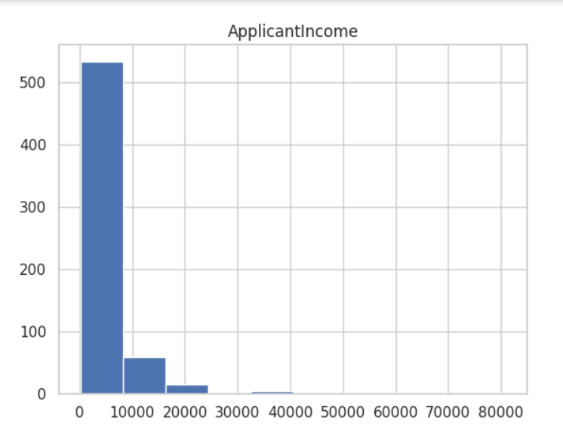
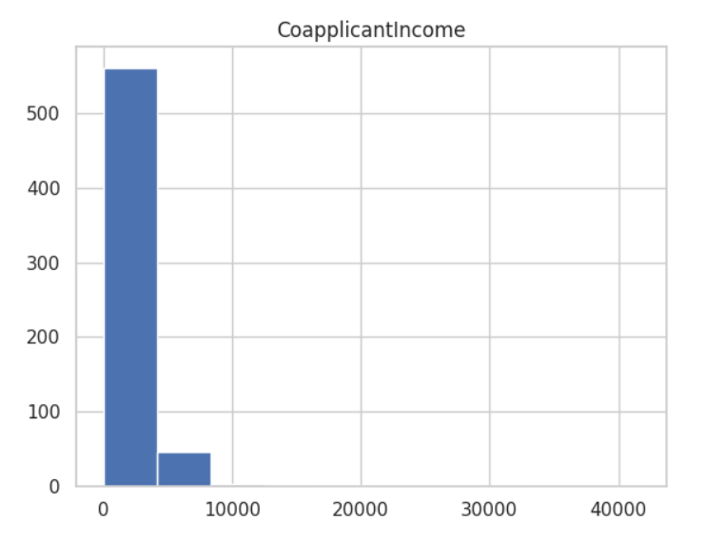
Numerical

Slide 15
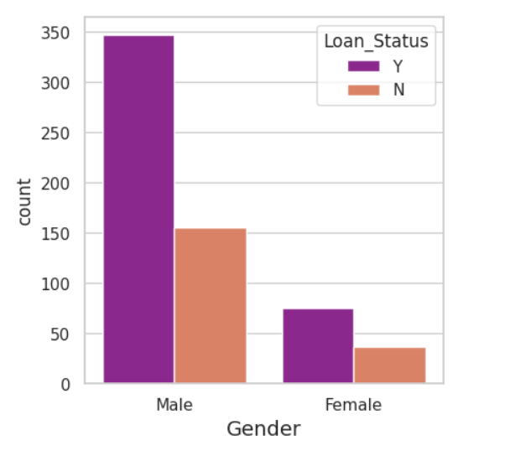
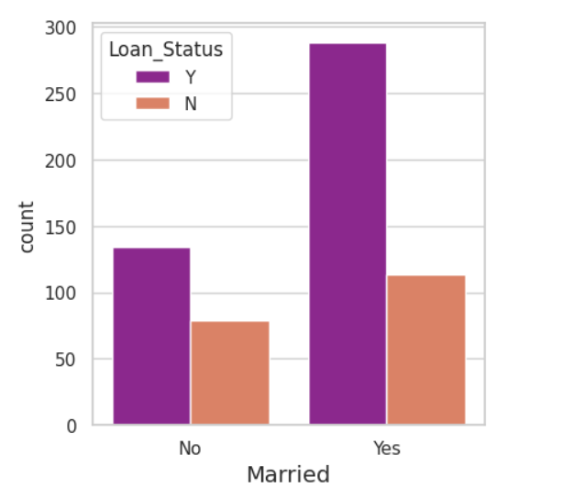
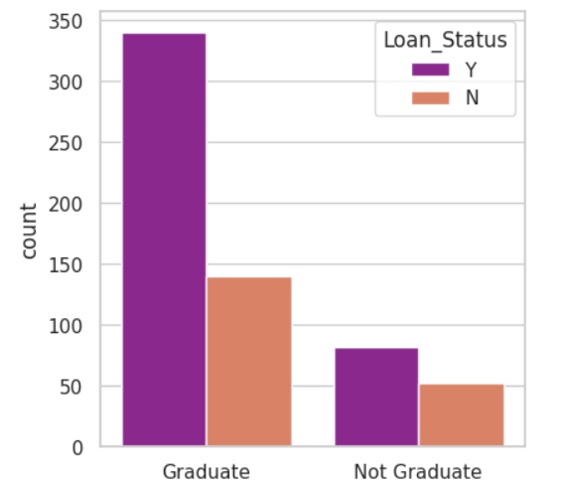
Categorical (split by Loan status)

Slide 16
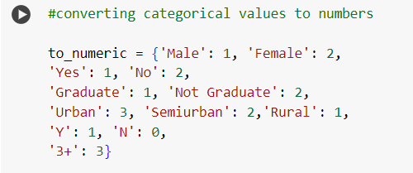

Categorical to numeric

Slide 17
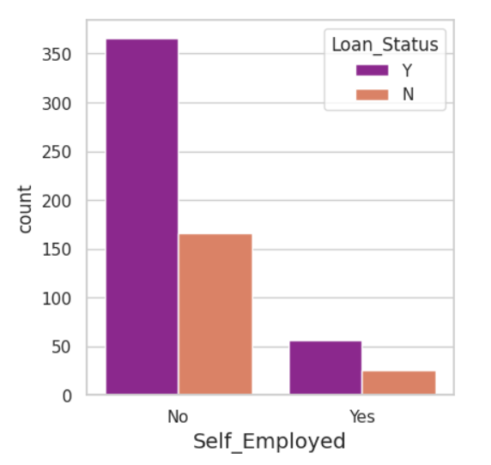
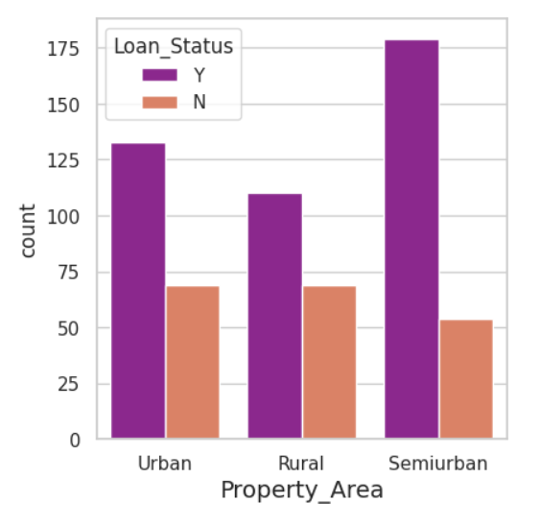

Slide 18
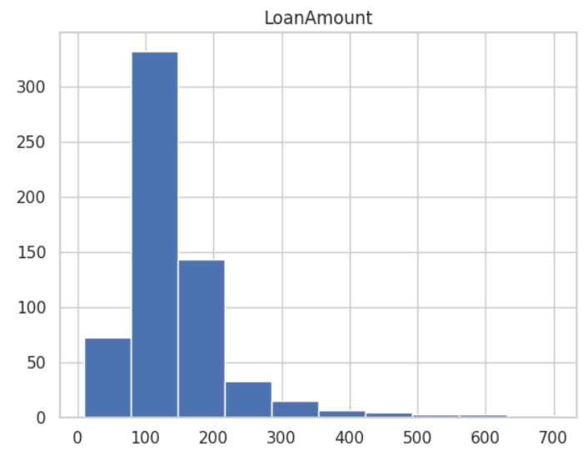
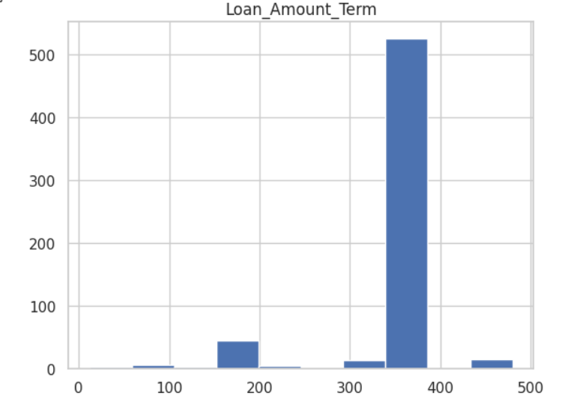

Slide 19
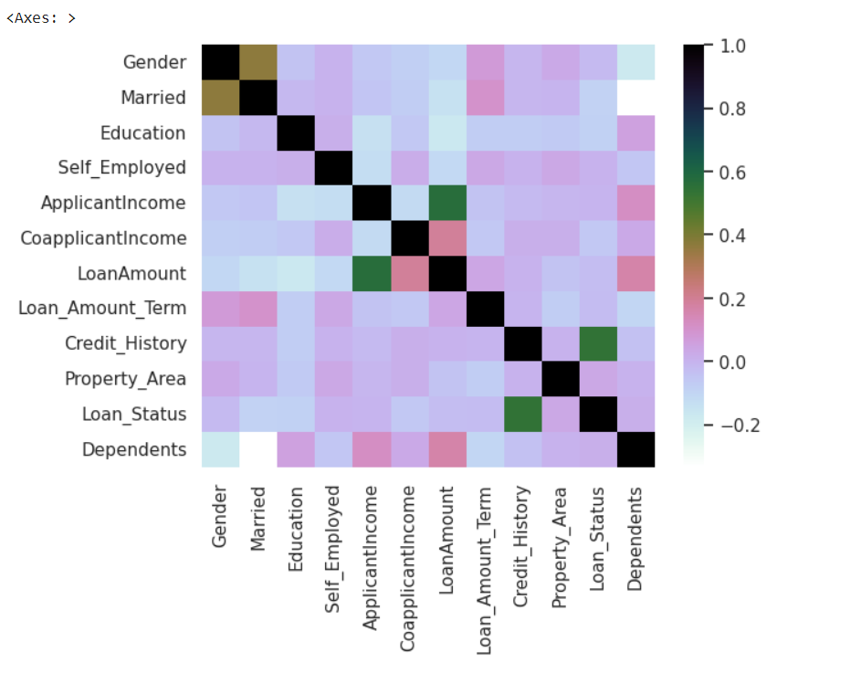
Correlation matrix

Slide 20
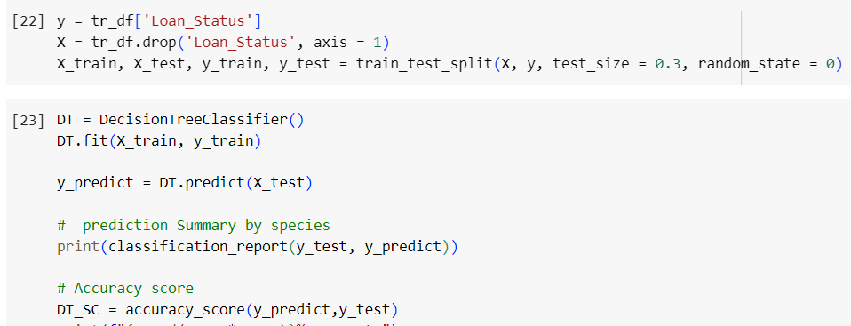
Algorithms decision tree classifier

Slide 21
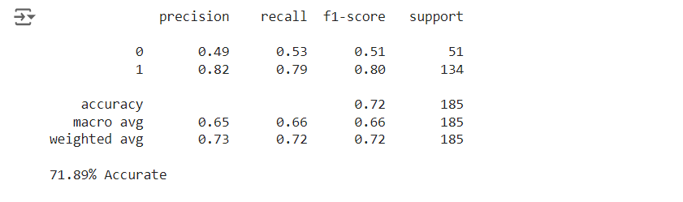
Output decision tree classifier

Slide 22
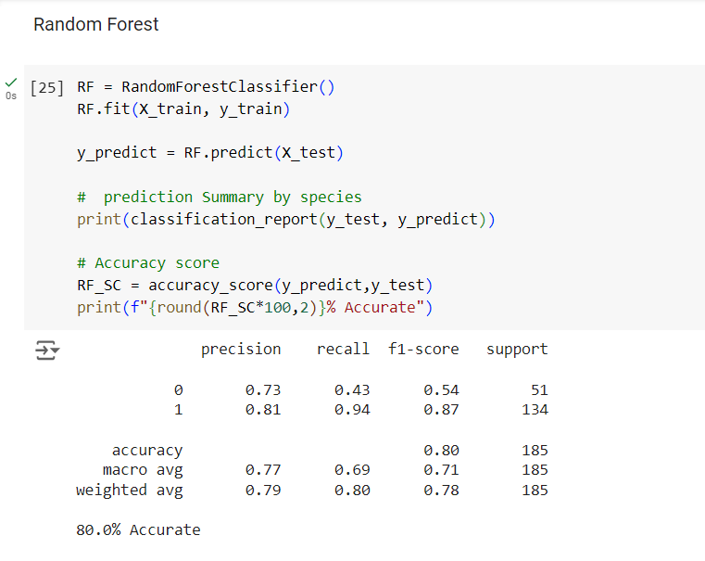
Random forest

